Slide 1
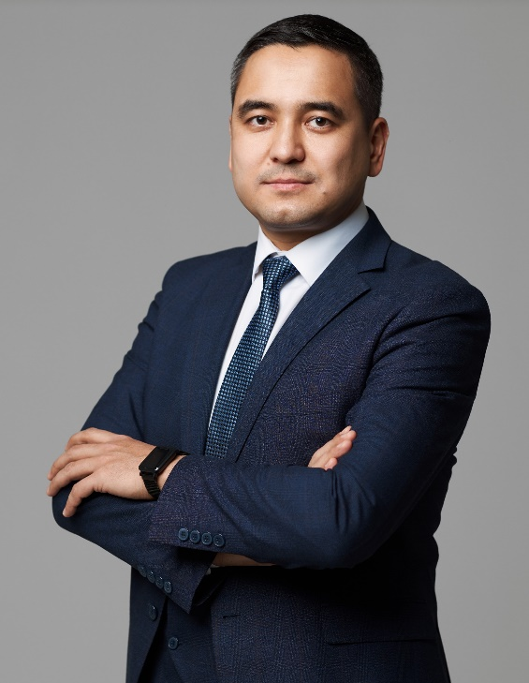
4th Global Takaful & Re-Takaful Forum 2022
Takaful practices and development perspectives in Uzbekistan
Umid
Hudayberdiev info@uzsugurta.uz
Dusit Thani Hotel, Dubai - UAE
August 24, 2022

Slide 2
We will talk about…
New Uzbekistan is open for business
Insurance market review
Takaful market facts and perspectives
First Uzbek Takaful company (project)
Mission and views
Partnership opportunities

Slide 3
Republic of Uzbekistan
Fast growing country in Central Asia
The largest population in region - 35M people
95% of population are Muslims
The historical land of Burhoniddin al-Marginoniy, Imam al-Moturidiy, Imam at-Termiziy and Imam al-Bukhari
New political course are open to business and also financial services sector

Slide 4
Uzbekistan: Insurance market
Market infrastructure and facts

Slide 5
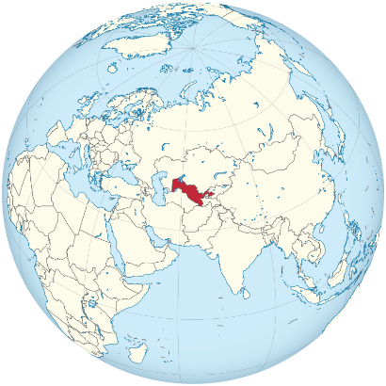
Professional participants of the insurance market
Insurance market development AGENCY under the Ministry of finance
Fund for Guaranteeing Payments for Compulsory third partie motor insurance
ASSOCIATION of Professional Participants of the Insurance Market
Insurers (42): - General (34) - Life (8)
Actuaries (5)
Insurance brokers (5)
Assistants, adjusters and surveyors (22)

Slide 6
Numbers of insurance industry
Insurance companies:
Life – 8
Non-life – 34 Insurance brokers – 5
Insurance agents – 8 800
Insurance professionals – 4 200
Insurance premiums share in GDP – 0,72%

Slide 7
Indicators of the insurance market (2021)
Compulsory insurance
Voluntary insurance
Compulsory insurance
(million USD)
(million USD)

Slide 8
Insurance premiums structure by insurance products in comparison
Uzbekistan (2021)
Post Soviet-Union Countries
(13 countries)
Property insurance
Comprehensive motor insurance
Loan risk insurance
Medical and accident insurance
Other products
Comprehensive Motor insurance
Commercial general liability
8,5%
Commercial general liability
Medical and accident insurance
Property insurance
Loan risk insurance
Transport risks
Cargo
Other products
1,2%
0,8%

Slide 9
TAKAFUL practices in Uzbekistan
From 2021 Conventional insurance company - Apex insurance started Takaful Window
Brand name – Apex Takaful
Sales:
– 2021 year displays poor sales
– 2022 year 2Q – 100 thousand USD
Insurance Portfolio structure
Motor insurance – 70%
Travel insurance – 28%
Others – 2%

Slide 10
TAKAFUL practices in Uzbekistan
O’zARO – public Islamic insurance society.
Offers wide range of Islamic financial services such as motor, public mutual insurance, mortgage and so.
Insurance marketing instrument and sales not developed at all
Now refocuses on consulting services on Islamic finance and education

Slide 11
TAKAFUL practices in Uzbekistan
Development Problems (Challenges and Issues):
Apex Takaful enters the market without certain marketing strategy
Clients have doubts to Islamic Window model in the borders of Conventional insurance company
O’zARO has difficulties in because people have doubts to rely on the company without license.
There is no legislation background, lack of investment instrument
Poor financial and insurance knowledge
There is no Islamic banking environment yet

Slide 12
TAKAFUL practices in Uzbekistan
Development Benefits:
Mostly Muslim population – 95%
Young population –– 70% (15-64 age group)
Conventional insurance covers mostly B2B
Individuals market almost free
Businesses have demand to Halal investment
The Government is planning to adopt the declaration that can open path to Takaful and Islamic investment

Slide 13
The FIRST Uzbek full-fledged TAKAFUL Company (project)
Started from 2022
Strategy
Build Takaful company on the basis of General insurance license using mostly Waqf model.
Marketing
Analyzing market, build communication and brand strategy, conducting surveys,
Sharia standards
We have our local consulting partner
Also we are negotiating with AlHuda CIBE on Takaful consulting

Slide 14
The FIRST Uzbek full-fledged TAKAFUL Company (project)
Media
We have own Media company that have 80% coverage of media and advertisement market. We offer have up to 70% discount.
We own SMM team, with audience more than 14M followers. 50K followers per celebrity or influencer.
Our CRM base counts more than 1M warm lids
Sales
We are designing sales strategy on online sales and through well educated and structured call-center
B2B – we are preparing team for corporate sales

Slide 15
Mission and background
Mission: Hoping the blessing of Allah to be the first to provide the comprehensive Takaful solution to Uzbek society. (Fard al-Kifayah)
Background:
18 years of experience in insurance, inc..
2 years – Insurance Supervisory Board
10 years – Top management
Tight networking among insurance professionals

Slide 16
Partnership opportunities
At this point of advancement of our product we came to idea that we have not enough experience in Takaful
Now we are open to partnership with International Takaful operator with best experience
We see partnership through investment
We are ready to provide all necessary information to our future partners
Welcome to Uzbekistan!!!

Slide 17
May Allah praise you all with abundance! Thank you for your attention!

